Slide 1


Green Pace
Security Policy Presentation
Developer: Grant Sorenson
Notes:
Hello, in this presentation I will outline Green Pace’s security policy including our principals and standards, some threats or vulnerabilities we face, an the steps we should take to minimize these threats.

Slide 2

OVERVIEW: DEFENSE IN DEPTH
The security policy outlined in this presentation will encompass security requirements and suggestions throughout the development lifecycle. By incorporating redundant layers of security through best practices, our objective should be to maintain system integrity while monitoring and fixing security risks. We will leverage triple A defense techniques and outline common vulnerabilities and assess their threat levels.
Notes:
The security policy outlined in this presentation will encompass security requirements and suggestions throughout the development lifecycle. By incorporating redundant layers of security through best practices, our objective should be to maintain system integrity while monitoring and fixing security risks. We will leverage triple A defense techniques and outline common vulnerabilities and assess their threat levels.

Slide 3
THREATS MATRIX
Likely: Standard security threats that are likely, some can be prevented through best coding practices and automation. Includes issues like do not attempt to modify string literals and do not pass non null terminated character sequence to library function that expects a string.
Unlikely: Security threats or vulnerabilities that are rare and typically found with automation. They include standards like not declaring or defining a reserved identifier and avoid side effects in arguments from unsafe macros.
Priority: These issues have high severity, likelihood, and priority. They should be fixed as soon as possible. They include vulnerabilities like code that accesses an object outside of its lifetime. This is a potential injection point.
Low Priority: These issues have low priority and are not threatening vulnerabilities to the system. They may cause inefficiency or hangups, but they will not severely threaten the system.
Some of these vulnerabilities can be located with automation, a library or IDE that can parse code and detect errors and potential security threats. Further security processes like unit testing can also be automated.
Likely STR30-C FIO32-C MEM52-CPP MEM50-CPP ERR51-CPP | Priority EXP54-CPP STR32-C
Low priority STR30-C DCL51-CPP PRE31-C | Unlikely STR53-CPP DCL51-CPP PRE31-C
Notes:
The threat matrix includes all the current issues we have tracked and organized into 4 distinct groups. Some may overlap due to their complexity, but overall, we have a list of likely and unlikely issues that differ in priority. High priority issues are be monitored and patched as soon as possible, while low priority issues are fixed depending on their threat level or severity. Likely issues include standard security threats that are likely, some can be prevented through best coding practices and automation. Unlikely issues are Security threats or vulnerabilities that are rare and may not be seen on a regular basis.

Slide 4
10 PRINCIPLES
Architect and Design for security policies: Exclude user input from format strings, Detect and handle memory allocation errors
Practice Defense in Depth: Do not access freed memory
Adhere to the principal of least privilege: Do not access freed memory
Adopt a secure coding standard: Exclude user input from format string, Range check element access
Validate Input Data: Exclude user input from format string
Default Deny: Exclude User input from format strings
Sanitize data sent to other systems: Do not pass a non-null terminated character sequence toa library that expects a string
Keep it Simple: Handle all exceptions
Heed Compiler Warnings: Do not attempt to modify string literals, Do not access freed memory
Use Effective quality assurance techniques: Avoid side effects in augments to unsafe macros
Notes:
The three most important principles include designing for security, practice defense in depth, and adhere to the principal of least privilege. While every principal should be followed, these 3 are the most important because they include ideas of implementing security early and include Zero trust as a best practice by incorporating least privilege.

Slide 5
CODING STANDARDS
Do not access freed memory
Detect and handle memory allocation errors
Exclude User input from format strings
Do not access an object outside of its lifetime
Handle all exceptions
Avoid side effects in arguments to unsafe macros
Do not pass a non-null-terminated character sequence to a library function that expects a string
Range check element access
Do not declare or define a reserved identifier
Do not attempt to modify string literals
Notes:
These standards are listed in order of priority. Security is one of the most important things when creating a system that will handle sensitive data, so thinking about it from the beginning and utilizing defense in depth techniques is essential. Coding standards that were still important but are more concerned with development and functionality were prioritized less over ones favoring security.

Slide 6
ENCRYPTION POLICIES
Encryption in Flight:
Data in flight or transit will be secured using encryption implemented with best practices
Data transmission system will be monitored with redundant levels of security
The system should require a device to be registered when transmitting sensitive data
Encryption at Rest:
Data at rest will be secured with encryption in a location that prevents outside access
Users requesting access to data will require prior authentication and authorization
The data will be monitored by an automated system that can detect possible breaches of security.
Encryption in Use
Data in use should be kept as secure as possible.
Data at this state is most vulnerable to attacks by a user
The system should have redundant levels of security to prevent possible attacks(SHARMA, 2020).
Notes:
Encryption in Flight: Data in flight or transit will be secured using encryption implemented with best practices. Data transmission system will be monitored with redundant levels of security for suspicious activity. The system should require a device to be registered when transmitting sensitive data and make data protection a top priority.
Encryption at Rest: Data at rest will be secured with encryption in a location that prevents outside access. Users requesting access to data will require prior authentication and authorization. The data will be monitored by an automated system that can detect possible breaches of security.
Encryption in Use: Data in use should be kept as secure as possible. Data at this state is extremely vulnerable to attacks by a user, so every effort should be made to secure and encrypt this data and prevent vulnerabilities. The system should have redundant levels of security to prevent possible attacks.

Slide 7
TRIPLE-A POLICIES
Authentication:
Any user requesting access to the system must supply credentials
Credentials supplied must match newest version in the system.
Services like geo-location can also be implemented for further security
Authorization:
Any user requesting an action must have sufficient privileges
A user should not be able to access functionality for which they do not have authorization.
Mutability of user privileges should only be available to the highest level of users.
Accounting:
There should be a record kept of all actions that a user takes
This log should only be available to those with the required privileges and not editable
Actions should be monitored for suspicious activity(What is AAA, 2023).
Notes:
Authentication: Any user requesting access to the system must supply credentials. Credentials supplied by a user should always be checked with the most updated version in the system. Services like geo-location can also be implemented for further security. The highest level of access to the system should be limited to a very small number of users.
Authorization: Any user requesting an action from the system must have sufficient privileges to provide authorization. A user should not be able to access functionality for which they do not have authorization. Mutability of user privileges should only be available to the highest level of users.
Accounting: There should be a record kept of all actions that a user takes. This log should only be available to those with the required privileges and not editable. Actions should be monitored for suspicious activity.

Slide 8
Unit Testing
The vulnerability I wanted to test was maintaining the integrity of a pointer object that’s holding a collection of data. Objects that include a data structures that could result in exceptions should be tested at their base class before being implemented to maintain system security and functionality.
In order to maintain the highest level of security, new objects or systems should undergo unit tests to ensure proper functionality. This time could also be utilized by running the code through an automated parser that can detect possible errors or vulnerabilities.
Notes:
The vulnerability I wanted to test was maintaining the integrity of a pointer object that’s holding a collection of data. Objects that include a data structures that could result in exceptions should be tested at their base class before being implemented to maintain system security and functionality.
In order to maintain the highest level of security, new objects or systems should undergo unit tests to ensure proper functionality. This time could also be utilized by running the code through an automated parser that can detect possible errors or vulnerabilities.

Slide 9
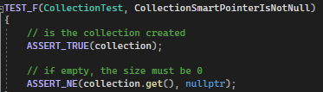
Is Collection Empty when Created
This test checks the pointer object collection is created and does not contain any additional data.

Slide 10
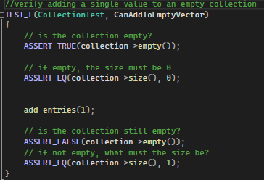
Can objects be added to collection
This test checks if objects can be successfully added to the data object collection. First we check to make sure collections is empty and contains no elements. We then add an element and ensure collection is not empty and contains one element.

Slide 11
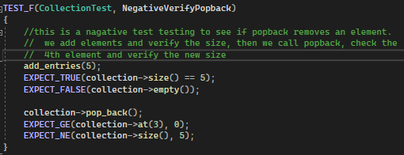
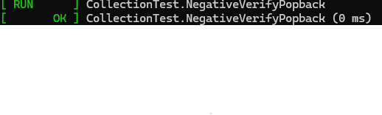
Does Popback() remove element
This test checks to see if the function pop_back() removes an element from the collection. Elements are added to collection, the size is verified, and then we call pop_back() and ensure the size is not equal to the originals.

Slide 12
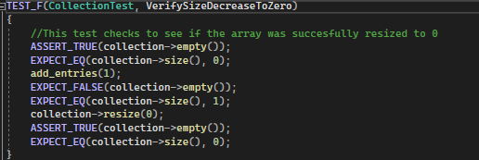
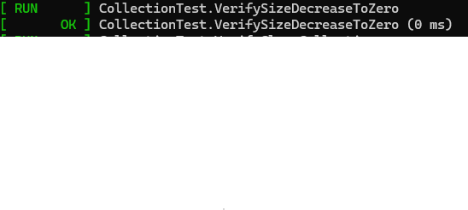
Can array be zeroed
This test ensures the data object can be zeroed out and reset. First we check to make sure the array is empty. Then we add an entry, and resize the array to 0. We then verify the entry has been removed and the size of the collection is 0.

Slide 13
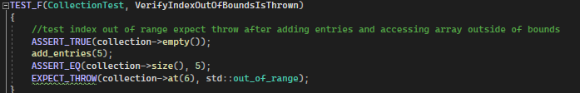
Is index out of bounds thrown properly
This test checks if the collection can properly throw an IndexOutOfBounds exception by accessing an invalid index. We first assert the collection in empty, then we add entries and verify the size. Then we attempt to access an invalid index which should throw an exception.

Slide 14

AUTOMATION SUMMARY
Notes:
Automation is important because it can help provide bug testing, vulnerability testing, and even be used to improve the process of creating builds or spinning up servers. I will describe where and how we could implement some helpful tools.

Slide 15
TOOLS
Implementation opportunities for automation reside at multiple points in the Dev Spec Ops diagram. In the very first stage automation software will be used to parse libraries and check for known vulnerabilities. Have secure source libraries is important because it provides a solid foundation to add and create new components. Automation could also be used for creating builds for different specifications or security protocols that should be included in early builds.
While designing the system, automation will be implemented for things like unit tests and vulnerability scanning. Automation at this stage can reveal functionality errors as well as potential vulnerabilities or weaknesses in code development. This is also where quality assurance can be used to find bugs and validate the functionality of the system. During the build and design phases a compiler will be used to create the executable that manages the application. The compiler can also be configured to warn the developer of unsafe code and find potential vulnerabilities.
Notes:
Implementation opportunities for automation reside at multiple points in the Dev Spec Ops diagram. In the very first stage automation software will be used to parse libraries and check for known vulnerabilities. Have secure source libraries is important because it provides a solid foundation to add and create new components. Automation could also be used for creating builds for different specifications or security protocols that should be included in early builds.
While designing the system, automation will be implemented for things like unit tests and vulnerability scanning. Automation at this stage can reveal functionality errors as well as potential vulnerabilities or weaknesses in code development. This is also where quality assurance can be used to find bugs and validate the functionality of the system. During the build and design phases a compiler will be used to create the executable that manages the application. The compiler can also be configured to warn the developer of unsafe code and find potential vulnerabilities.

Slide 16
RISKS AND BENEFITS
Allocating more money to security and providing training for developers
Potential cost of implementation and maintenance
Extra work and expertise required by the developers
Hiring a team or contract another company to manage security
Breaches less likely in the future
More detail on testing methods and the extent that QA is involved with security
Many vulnerabilities that could be caught at the testing phase
risks of implementing security too fast
leaving systems out
compromising on certain aspects to make a deadline
This should be avoided when developing security because
Notes:
A few of the problems include the potential cost of implementation and maintenance, and the extra work and expertise required by the developers. These problems can be solved by allocating more money to security and providing training for developers. Any type of security implemented will require direction and expertise, which would include hiring a team or contract another company to manage security. Providing better security now will make breaches less likely in the future. If security is left for the end, some vulnerabilities could be missed, and it will be even more difficult to implement security measures. This strategy could use more detail on testing methods and the extent that QA is involved with security. There are many vulnerabilities that could be caught at the testing phase like unhandled input and logic errors. Some of the risks of implementing security too fast include leaving systems out or compromising on certain aspects to make a deadline. This should be avoided when developing security because it is extremely important to the overall product. Prioritizing security will ensure a tight system and reduce the potential for breaches in the future.

Slide 17
RECOMMENDATIONS
implement security measures that would block most attacks while being able to alert the security team that an attack occurred
detect which part of the overall system was attacked, in what way, and a classification of the severity of the attack
The importance of competent security can be seen in the Aadhaar breach that occurred in January 2018. Attackers were able to steal personal information as well as credit information because of unsafe API protocols(Hill & Swinhoe, 2022).
Human error
attackers manipulate employees or individuals with system access.
common vulnerability that has been taken advantage of to attack a system.
Pegasus airlines(Pryimenko, 2024)
Training for employees is recommended
encourage employees to be on the lookout for phishing attacks and bad actors.
Notes:
While this security policy covers many areas that could lead to potential vulnerabilities, there is always room for improvement and security upgrades. We want to implement security measures that would block most attacks while being able to alert the security team that an attack occurred. We should get a system in place that can detect which part of the overall system was attacked, in what way, and a classification of the severity of the attack. This will help improve security in the future if the system is kept up to date and new security features are added. The importance of competent security can be seen in the Aadhaar breach that occurred in January 2018. Attackers were able to steal personal information as well as credit information because of unsafe API protocols(Hill & Swinhoe, 2022).
One area of security that’s particularly hard to stop is when attackers manipulate employees or individuals with high level access. Human error is a common vulnerability that has been taken advantage of to attack a system. For example, Pegasus airlines left most of their sensitive data public when a cloud server was misconfigured by a developer, allowing attackers to steal data(Pryimenko, 2024). Training for employees is recommended to prevent attackers from capitalizing on human error, and a standard should be put in place to encourage employees to be on the lookout for phishing attacks and bad actors.

Slide 18
CONCLUSIONS
Implementing the security standards and principals
Vulnerability identification and automation.
Time and money
Protect the effectiveness and reputation of the product
Thinking about security throughout the development lifecycle
Improve the developer's ability to know where vulnerabilities could occur
Zero Trust
Reducing blind spots and improve its ability to find potential bad actors
Never share credentials
Common vector for attack
Notes:
By implementing the security standards and principals we could significantly improve our security. Through vulnerability identification and automation, we can implement tools that make incorporating security easier while finding errors and vulnerabilities faster. While it may take time and money, it will protect the effectiveness and reputation of the product. A few standards that should be adopted to prevent future problems include thinking about security throughout the development lifecycle, Zero Trust, and never share credentials. Always thinking about security will improve the developer's ability to know where vulnerabilities could occur and provide solutions more efficiently. This will also encourage the developer to code defensively and think about how security should be implemented. The security system should adopt a policy of Zero Trust, assuming any user could be a potential attacker. This will improve the security of the system by reducing blind spots and improve its ability to find potential bad actors(Jakkal, 2023). An important employee standard to include is never sharing credentials or sensitive company information. An Agent ID article stated that according to IBM, nearly 20% of breaches occur due to unsafe employee credential policy. This makes it a common vector for attack and an area in which security should be prioritized(2020).

Slide 19
REFERENCES
Agent, I. D. (2020, August 11). Password Sharing is a Data Breach Danger. ID Agent. https://www.idagent.com/blog/password-sharing-creates-data-breach- danger/#:~:text=Password%20sharing%20among%20your%20staffers%20could%20open%20your
Hill, M., & Swinhoe, D. (2022, November 8). The 15 biggest data breaches of the 21st century. CSO Online. https://www.csoonline.com/article/534628/the-biggest-data-breaches-of-the-21st-century.html
Jakkal, V. (2023, February 27). 5 ways Microsoft supports a Zero Trust security strategy. Microsoft Security Blog. https://www.microsoft.com/en-us/security/blog/2023/02/27/5-reasons-to-adopt-a-zero-trust-security- strategy-for-your-business/?culture=en-us&country=us
Pryimenko, L. (2024, February 28). Top 5 Real-Life Examples of Breaches
Caused by Insider Threats. Ekransystem.com. https://www.ekransystem.com/en/blog/real-life-examples- insider-threat-caused-breaches
SHARMA, J. (2023, August 16). Data Encryption: Securing Data at Rest and in Transit with Encryption Technologies. DEV Community. https://dev.to/documatic/data-encryption-securing-data-at-rest-and-in-transit-with- encryption-technologies-1lc2
What is AAA (Authentication, Authorization, and Accounting)? (2020, April 29). GeeksforGeeks. https://www.geeksforgeeks.org/what-is-aaa-authentication-authorization-and-accounting/

